Slide 1

M I N O R - P R O J E C T ON ‘Angular JS’
Online Food Ordering

Slide 2


Submitted by : RIPAM KUNDU 14271021001
Meghnad Saha Institute of Technology
Meghnad Saha Institute of Technology (MSIT), one of the pioneering Degree Engineering Colleges of Kolkata, is approved by AICTE and affiliated to WBUT. It began its journey on September 5, 2001

Slide 3

Project Description
The labour rates are increasing steadily year on year thus making it difficult to find employees. The food industry is highly labour intensive and the biggest expense in the food industry is the cost of employing the right kind of people to do the work. One of the ways to reduce this expense is to use modern technology to replace some of the jobs done by human beings and make machines do the work. Here we propose an “Online Food Ordering System” that has been designed for Fast Food restaurant, Take-Out or College Cafeterias. The system can also be used in any food delivery industry. This simplifies the process of food ordering for both the customer and the restaurant, as the entire process of taking orders is automated..

Slide 4

ACKNOWLEDGEMENT
I would like to express my special thanks of gratitude to our respected teacher MR. SUBHJIT SANTRA who gave us the golden opportunity to do this wonderful project on the topic “ONLINE FOOD ORDERING”, which also helped us in doing a lot of research and we came to know about so many new things I am really thankful to them.
Secondly, we would also like to thank our friends who helped us a lot in finalizing this project within the limited time frame.

Slide 5

Abstract
Our proposed system is an online food ordering system that enables ease for the customers. It overcomes the disadvantages of the traditional queueing system. Our proposed system is a medium to order online food hassle free from restaurants as well as mess service. This system improves the method of taking the order from customer. The online food ordering system sets up a food menu online and customers can easily place the order as per their wish. Also with a food menu, customers can easily track the orders. This system also provides a feedback system in which user can rate the food items. Also, the proposed system can recommend hotels, food, based on the ratings given by the user, the hotel staff will be informed for the improvements along with the quality. The payment can be made online or pay-on-delivery system.
The online food ordering system sets up a food menu online and customers can easily place the order as per they like. Also with a food menu, online customers can easily track the orders. The management maintains customers database, and improve food delivery service. The Restaurant management systems motivates us to develop the system. There are various facilities provided so that the users of the system will get service effectively. Also, the system considers Restaurants as well as Mess facility to the customers. Again, the idea comes that mostly mess users are person who are shifted for various reason in new cities. So, they are interrelated.
Overall, the project of ours is being developed to help the people food without any possible physical boundaries.

Slide 6

Software Requirement Specification
Software
Operating System
1. OS Windows 7,8,10 (owned)
2. Linux
3. MAC OS
Web Browser
1. Internet Explorer 7
2. Google Chrome
3. Mozilla Firefox
3. All web browser i.e. supported by JavaScript.
Hardware
1. CPU dual core
2. HDD-100 GB
3. RAM-4 GB or more

Slide 7



Project Development tools
Software used
Notepad++
or
Visual Studio Code
Node JS
Frontend
HTML
CSS
BootStarp
NodeJs
AngularJS
7

Slide 8

Modules
Login System.
Ordering System.
Wishlist System
Payment System.
ONLINE FOOD ORDERING

Slide 9
Cocomo Model
COCOMO Model–The Constructive Cost Model is a software cost estimation model based on an algorithm. It was developed by Barry Boehm first published in 1981.
CALCULATIONS: here the values depend on the types of software products or projects. We have just told that our software project is of organic type. So according to that the values of
a1=2.4
b1=1.05
c1=2.5
d1=0.38
In our project the estimated line of code(LOC) is 4064. So the estimated size of the project is 4.64 KLOC. Hence considering it to be organic software the following is calculated
We know that, Effort= a1*(KLOC) ^{b1} person month Here, KLOC-Thousands or kilos of lines of code
=2.4*(4.64)^{1.05}PM
=12.024 PM
Finally, Time for Development (Tdev)= c1*(EFFORT) ^{d1} Months
=2.5*(12.024)^{0.38} Months
=3.644 Months
≈ 3 Months

Slide 10
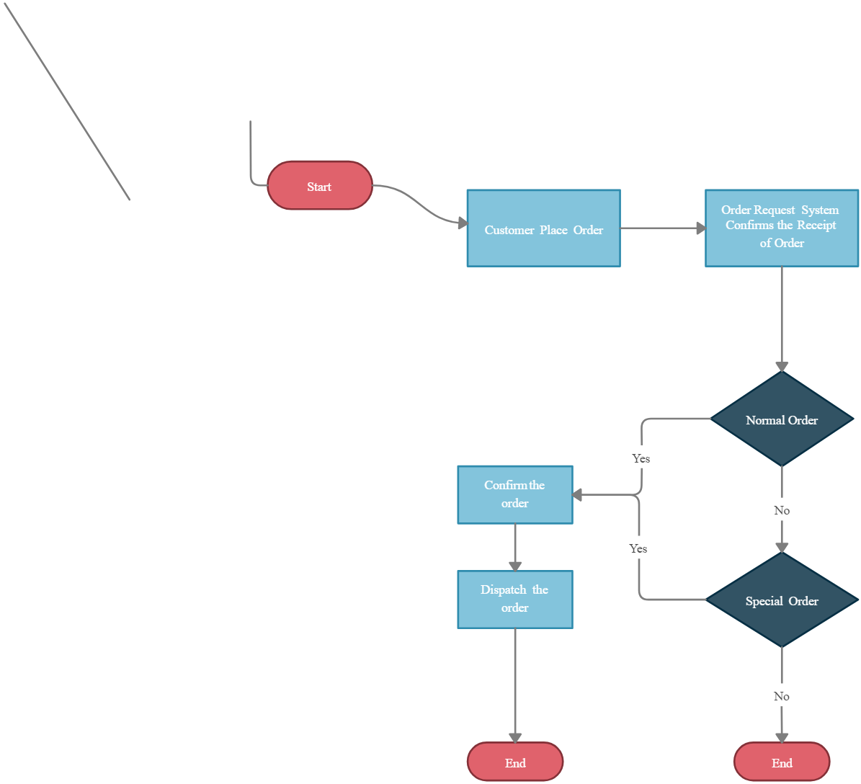
Flow Chart

Slide 11
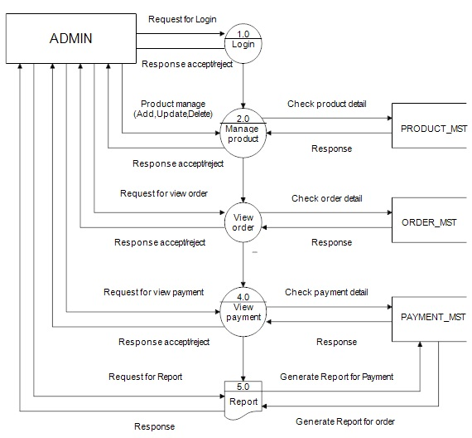
Data Flow Diagram [ DFD ]

Slide 12
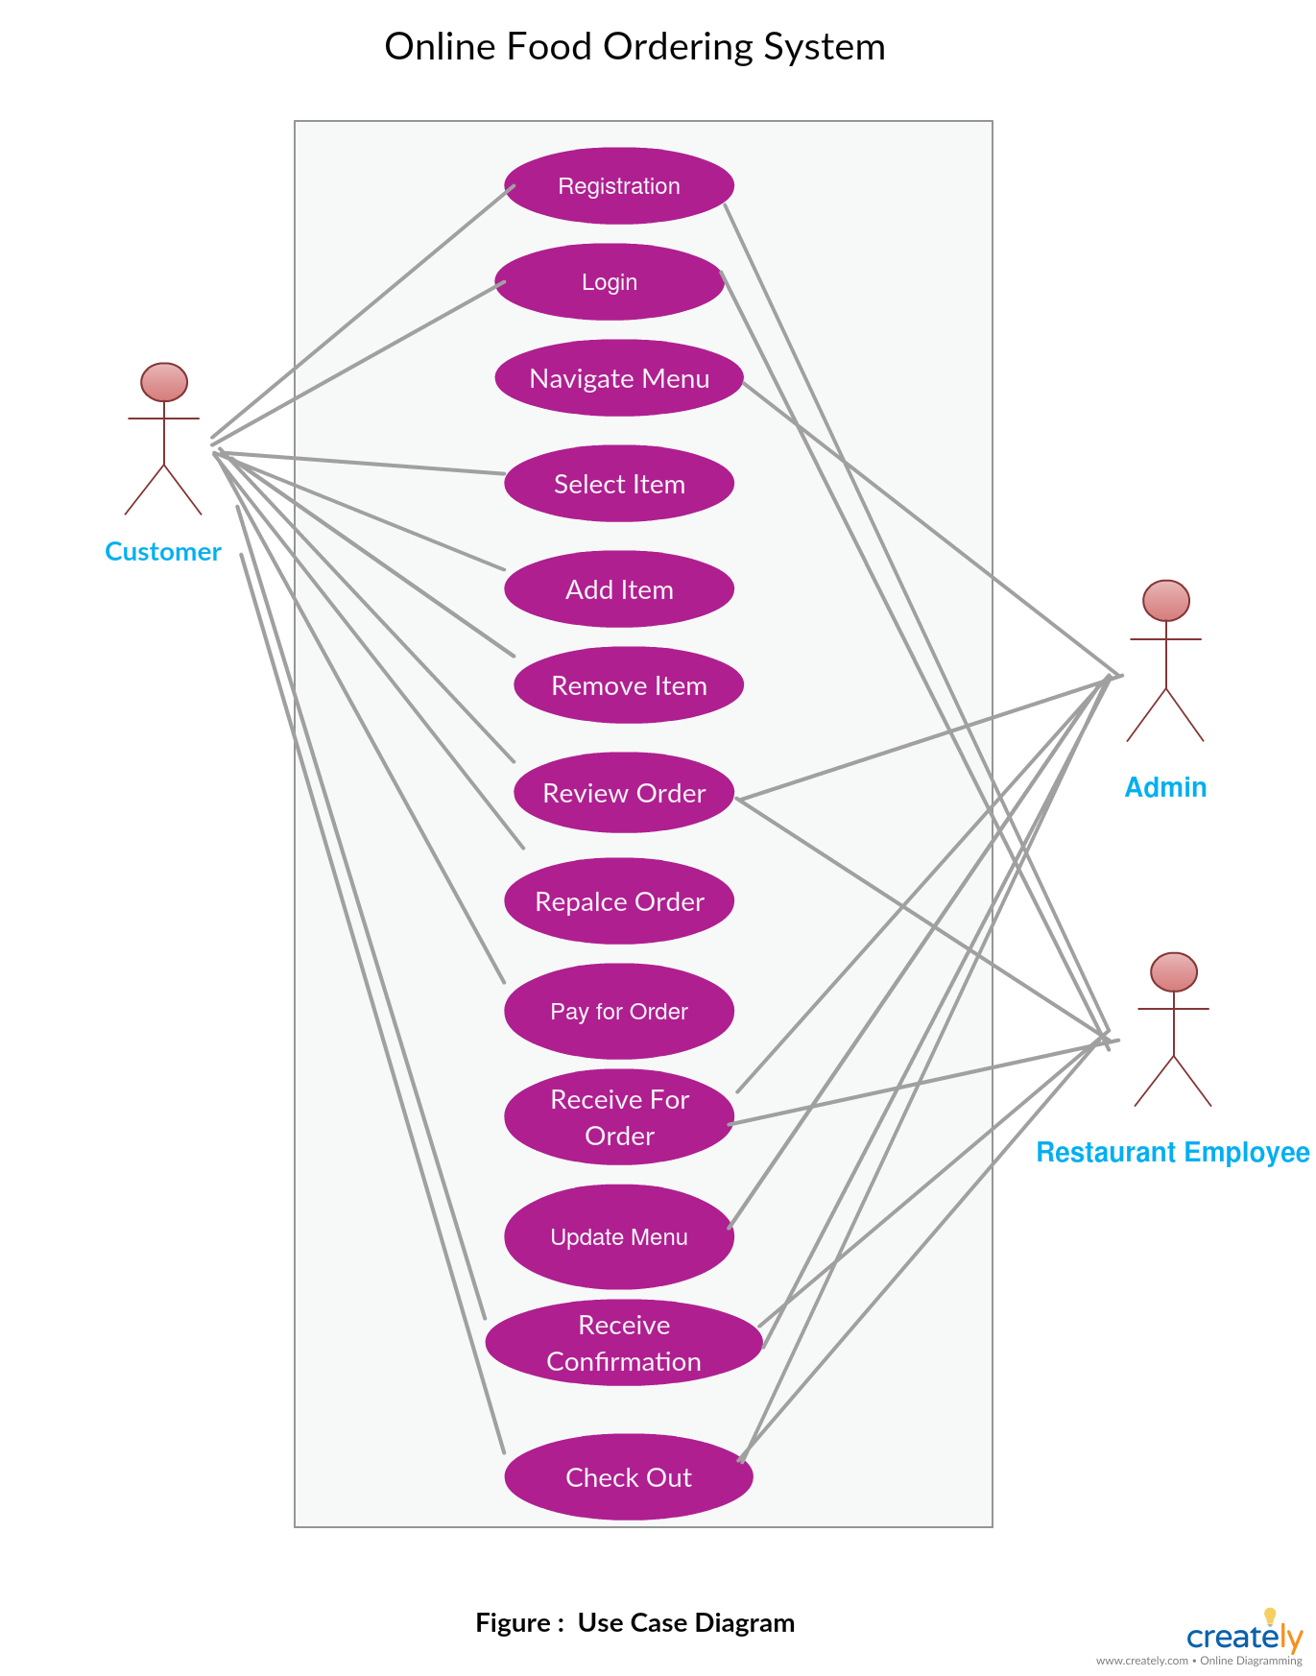
Use Case Diagram

Slide 13
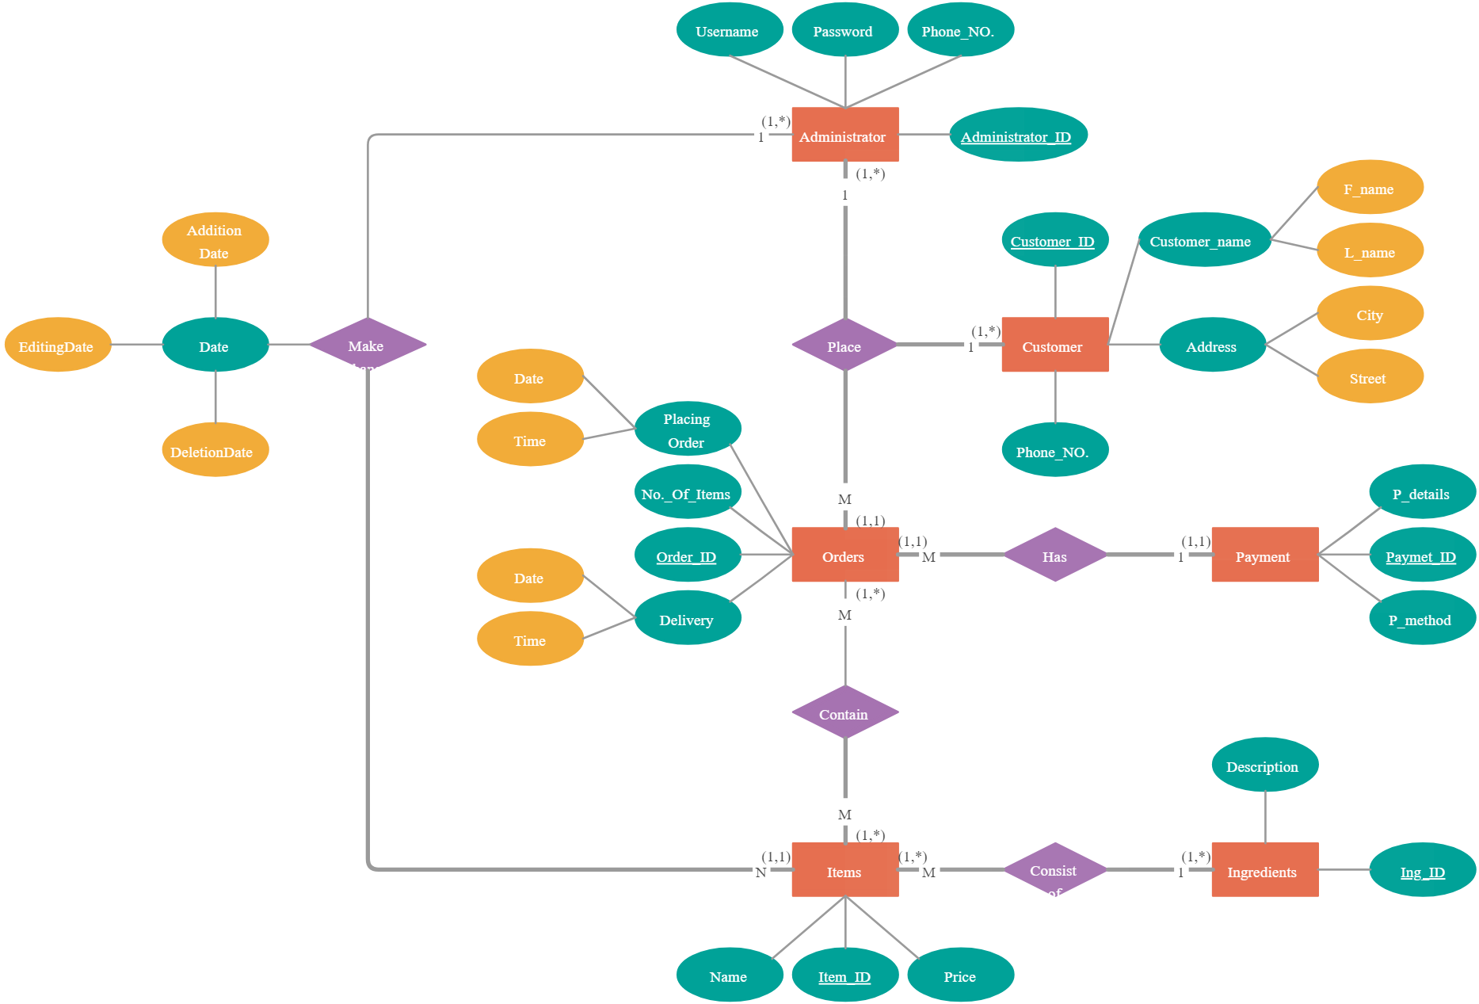
ERD (Entity Relationship Diagram)

Slide 14
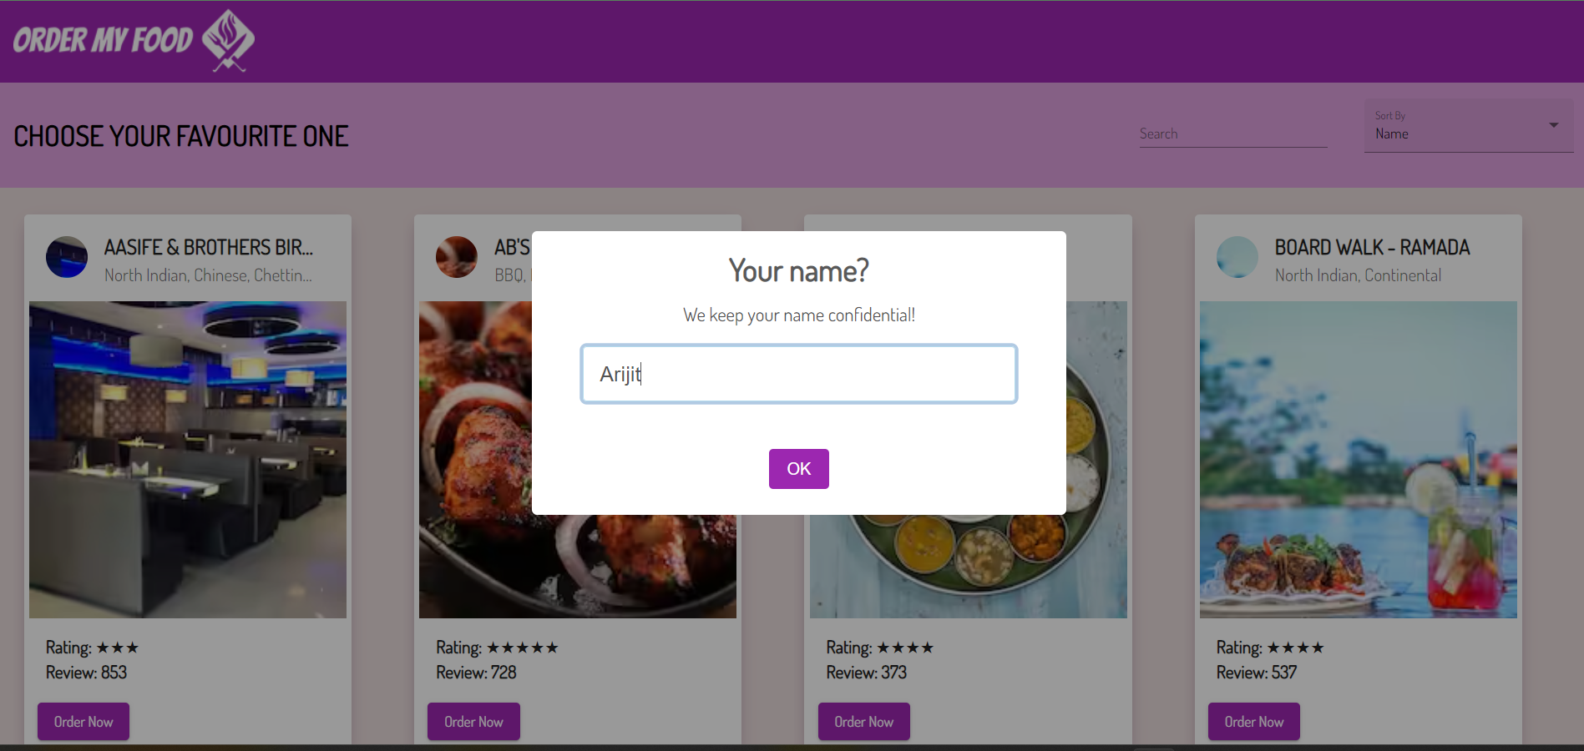
Login Page

Slide 15
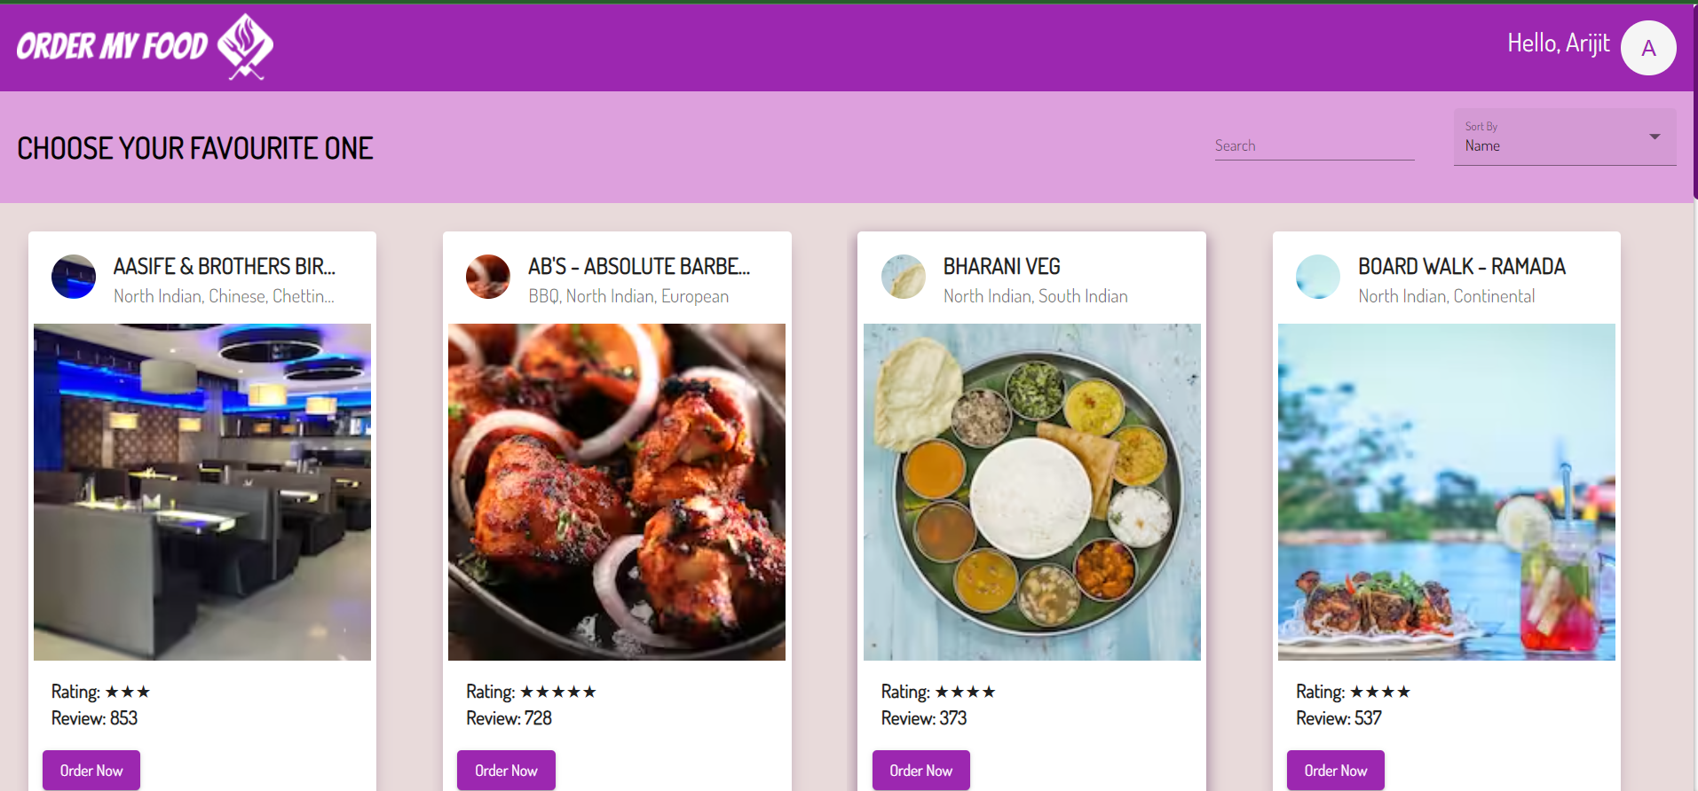
Home Page

Slide 16
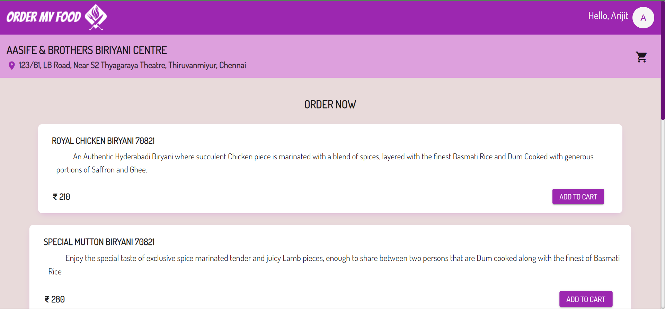
Order Page

Slide 17
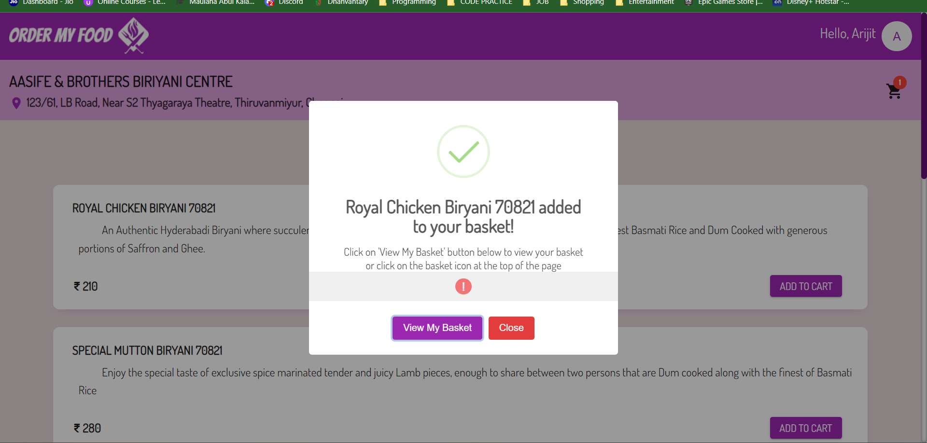
Basket Page

Slide 18
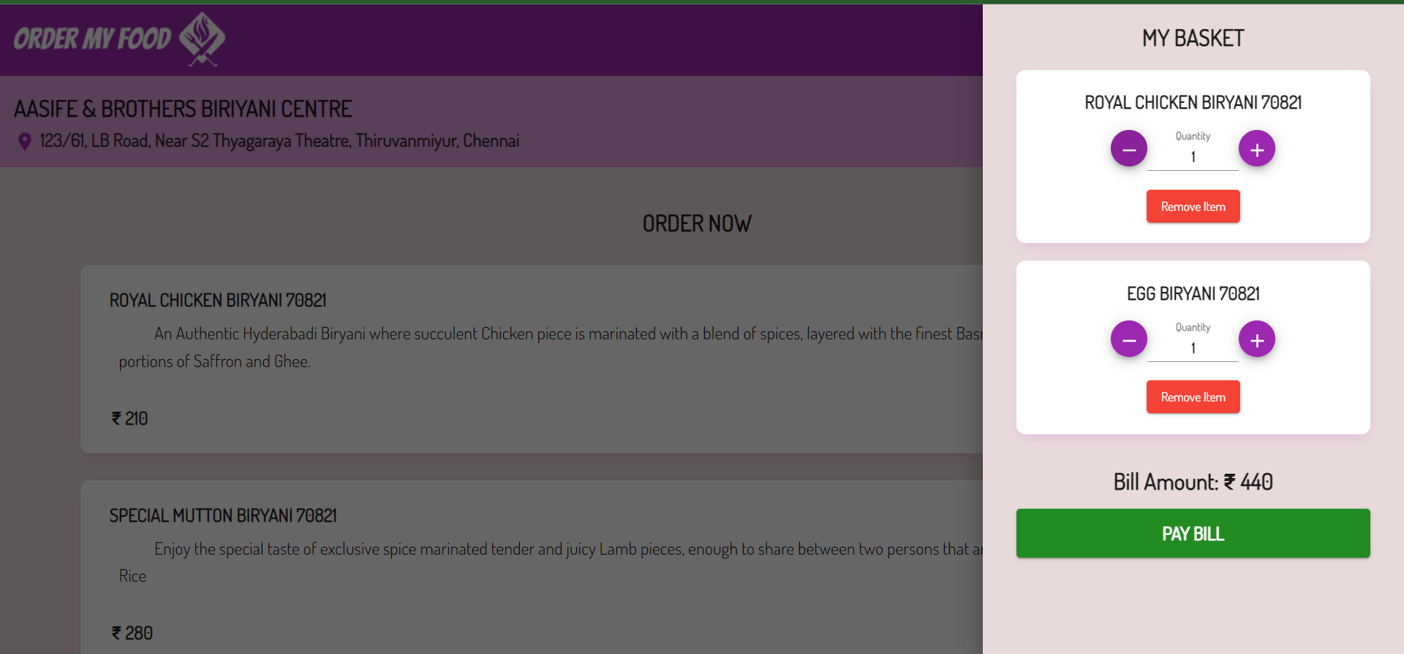
Bill Paying Page

Slide 19
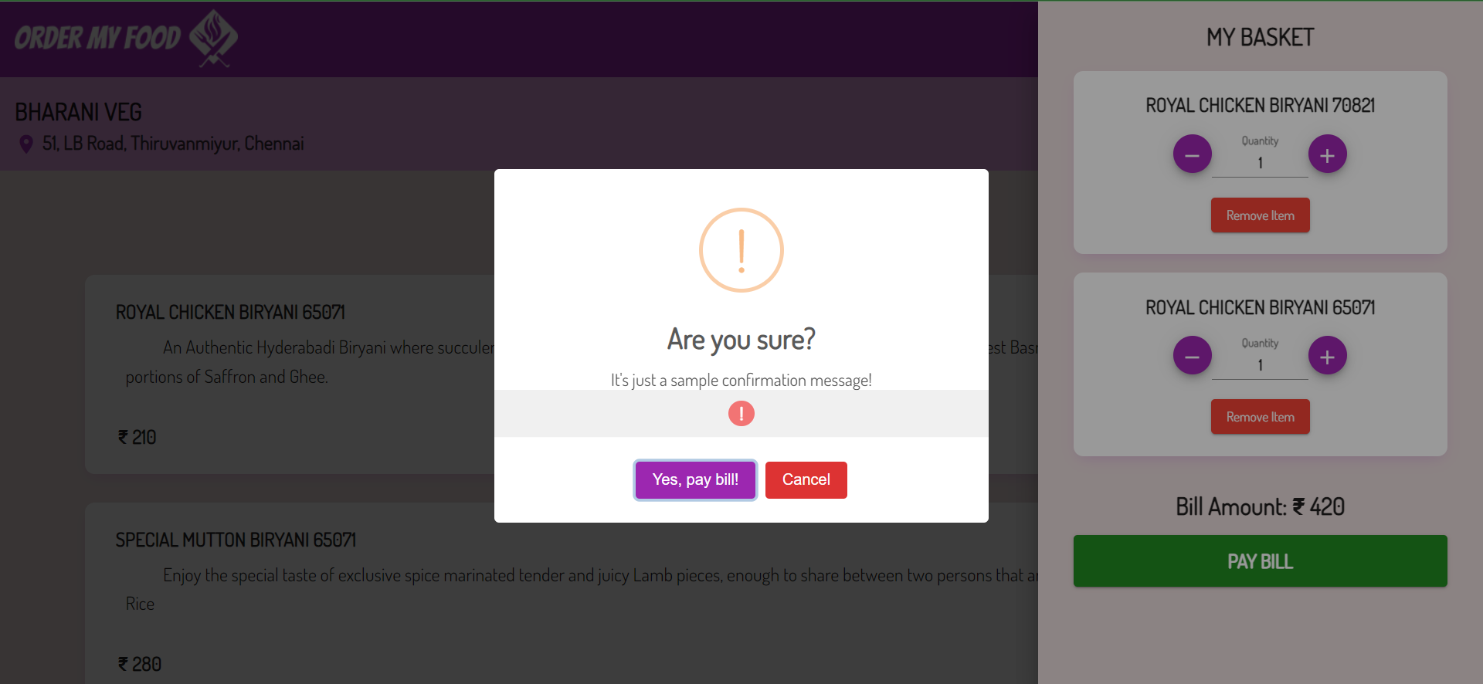
Conformation page

Slide 20
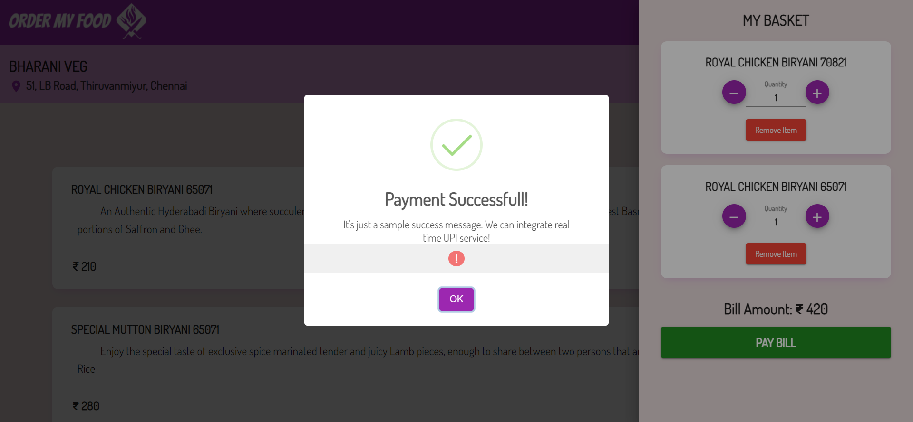
Payment Successful Page

Slide 21

FUTURE SCOPE OF THE PROJECT
The main purpose of an online ordering system is to provide customers for a way to place an order at a restaurant over the internet. This order food online system project aimed at developing an online food ordering system that can be used in small places, and medium cities firstly and then on a large scale. It is developed to help restaurants to simplify their daily operational and managerial tasks as well as improve the dining experience of customers. And also helps restaurants develop healthy customer relationships by providing good services. The system enables staff to update and make changes to their food and beverage list information based on the orders placed and the orders completed.
In future we would like to keep working on this project and make a new addition to provide users with more advanced features and more detailed information. We have set our sights on the following additions in future: -
Forget password for admin and councilor.
Online payment process through debit and credit card.
Auto mail will be sent to the user’s email-id when new user creates their ID.

Slide 22

Conclusion of the project
An online food ordering titled “ ONLINE FOOD ORDERING ”, system is developed where the customers can make an order for the food and avoid the hassles of waiting for the order to be taken by the waiter. Using the application, the end users register online, read the E-menu card and select the food from the e-menu card to order food online. Once the customer selects the required food item the chef will be able to see the results on the screen and start processing the food. This application nullifies the need of a waiter or reduces the workload of the waiter. The advantage is that in a crowded restaurant there will be chances that the waiters are overloaded with orders and they are unable to meet the requirements of the customer in a satisfactory manner. Therefore by using this application, the users can directly place the order for food to the chef online.

Slide 23

Refarence
A listing of different sources that were used in designing , developing ,carrying out and understanding the development are :
www.nevonprojects.com
www.tutorialspoint.com
www.geeksforgeeks.org
www.w3schools.com
www.studentprojectguide.com
Class Notes
ONLINE FOOD ORDERING

Slide 24

Thank you

